Slide 1
Multiple Regression
Data Engineering Candidate – Priyanka Brahmbhatt

Slide 2
Multiple Regression
Multiple Regression is basically the same as Bivariate regression except that you have more than one independent variable.
That is, you still have one dependent variable (Y)
But you have several independent variables (X1, X2, etc.)
Each independent variable will have a coefficient assigned to it.
The equation still produces only one estimate for Y for each record (e.g.,. Respondent, month, etc.)
Open up the Europe.xlsx worksheet in the Chapter 10 data folder on Blackboard
The data set includes the following variables:
Population (in millions)
Computer sales (in millions of US dollars)
Sales per capita (in US dollars)
GNP per head
Average Unemployment Rate 2002-2007
Percentage of GNP spend on education

Slide 3
Multiple Regression (cont’d)
Let’s model Per Capita Computer Sales (Sales/Capita)…that is, Sales/Capita = Y = our dependent variable
The predictors (Xs, independent variables) in the equation will be Per Capita GNP (GNP per head), Unemployment rate and %age spend on education (so 3 independent variables)
We will get an equation in the form:
Y = β ₀ + β ₁X₁ + β ₂X₂ + β ₃X₃ + error term,
Where Y is the dependent variable (sales/capita)
β ₀ is the constant or intercept
β ₁ is the coefficient for the 1st variable (Per Capita GNP) and X₁ is the value of the variable for that record, etc.
The error term is understood to be part of the equation, but we don’t typically write anything out for the error term. It’s basically the difference between the predicted value from the regression equation and the observed value for that record
Note, the βs are the same for all records, but the value of X varies for each record.

Slide 4
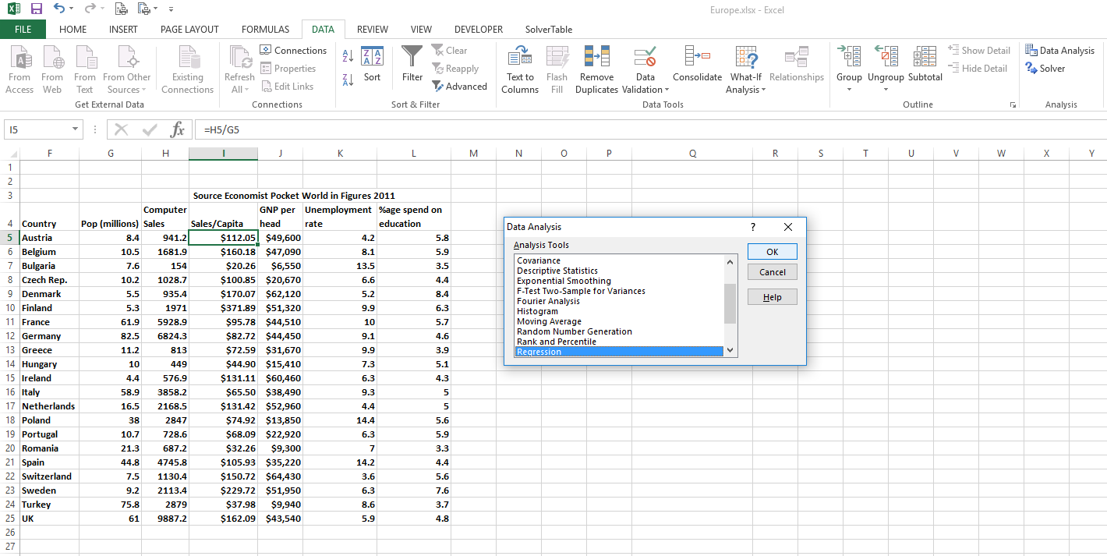
Multiple Regression (cont’d)
Use the Data Analysis Toolpak to estimate the regression equation:

Slide 5
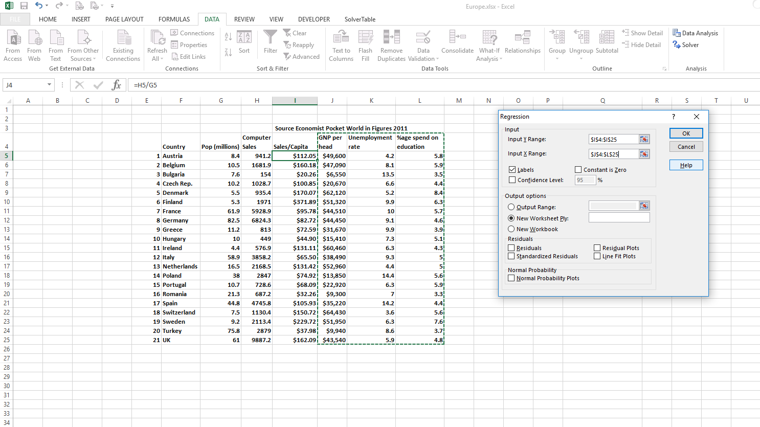
Multiple Regression (cont’d)

Slide 6
Multiple Regression (cont’d)
You should get the following output:
Thus, the regression equation would be Sales/Capita = -114.8351503 + .002297712*GNP per head + 4.219524573*Unemployement rate + 21.4226983*%age spend on education
And the R Square of the model tells us that these three variables collectively account for 53.45% of the variation in Computer Sales/Capita

Slide 7
Multiple Regression (cont’d)
In terms of interpretation, beyond the R-square the coefficients themselves, we usually look at the “P-values” for the F-statistic (“Significance F”) from the ANOVA and for each coefficient in the equation (literally “P-values”)
These “P-values” represented the probability of committing Type I (or α) error. That is, the probability that we accept the result as “true” (or representative), when it is in fact not.
By convention, we typically look for p-values where α < .05. This would equate to having 95% confidence that the effect is “real” (i.e., does not arise due to random sampling error)
The p-values here tell us that our overall model is significant (p = .003940222, which is < .05), but that only one independent variable is actually statistically significant (GNP per head, p = .027355)

Slide 8
Multiple Regression (cont’d)
What to do with insignificant variables (P-value > .05)?
The textbook mentions that you can drop them and re-run the regression with some caveats about checking for outliers
From a scientific perspective, I would argue that if the theory guiding your model suggests that the variable has or could have an effect on the dependent variable, you should leave it in.
Insignificant variables may still affect the relationship between the other independent variables and the dependent variable
Interpreting the coefficients
The coefficients basically express the change in the dependent variable associated with a 1-unit change in the independent variables, holding all else equal (aka ceterus parabis)

Slide 9
Standardized Coefficients (Betas)
Sometimes you want to compare the effect of different variables in a regression equation (e.g., which one has the stronger effect? or which one is more “important”?)
Comparing metric (i.e., the “regular” or “one-unit change”) coefficients can be misleading when the variables are measured in different units or even if the variability of the two measure differ greatly
Standardized coefficients (also known as “betas”) can be used for this purpose
Most statistical software packages (like SPSS or SAS) produce betas along with the metric coefficients
UNFORTUNATELY, Excel’s regression tools do not produce betas
There is a way to produce the standardized coefficients, but it involves standardizing the input data.
First, let’s look at the easy way (i.e., using SPSS)…

Slide 10
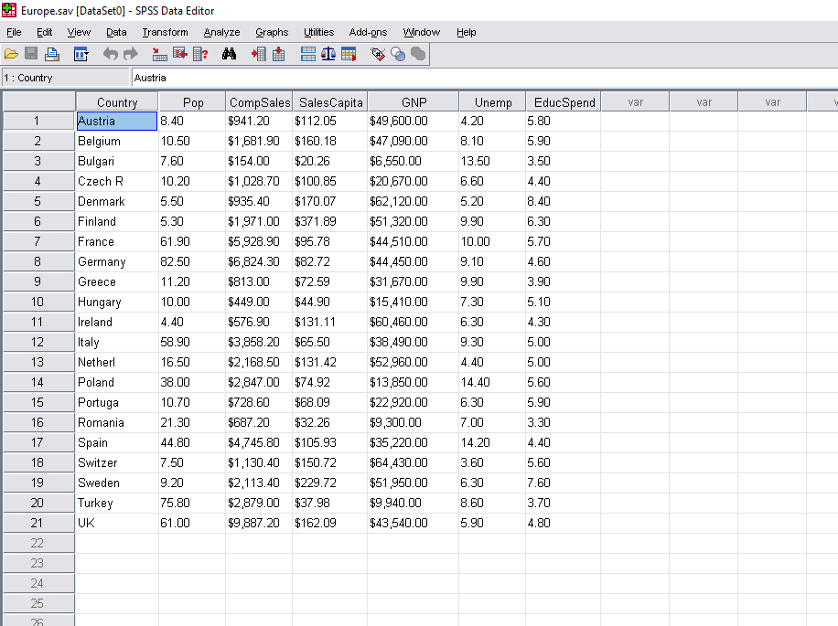
Standardized Coefficients (cont’d)
Download the Europe.sav data file from Blackboard. This is the same data that we have in the Europe.xlsx file, but in an SPSS data file.
Open up the file in SPSS

Slide 11
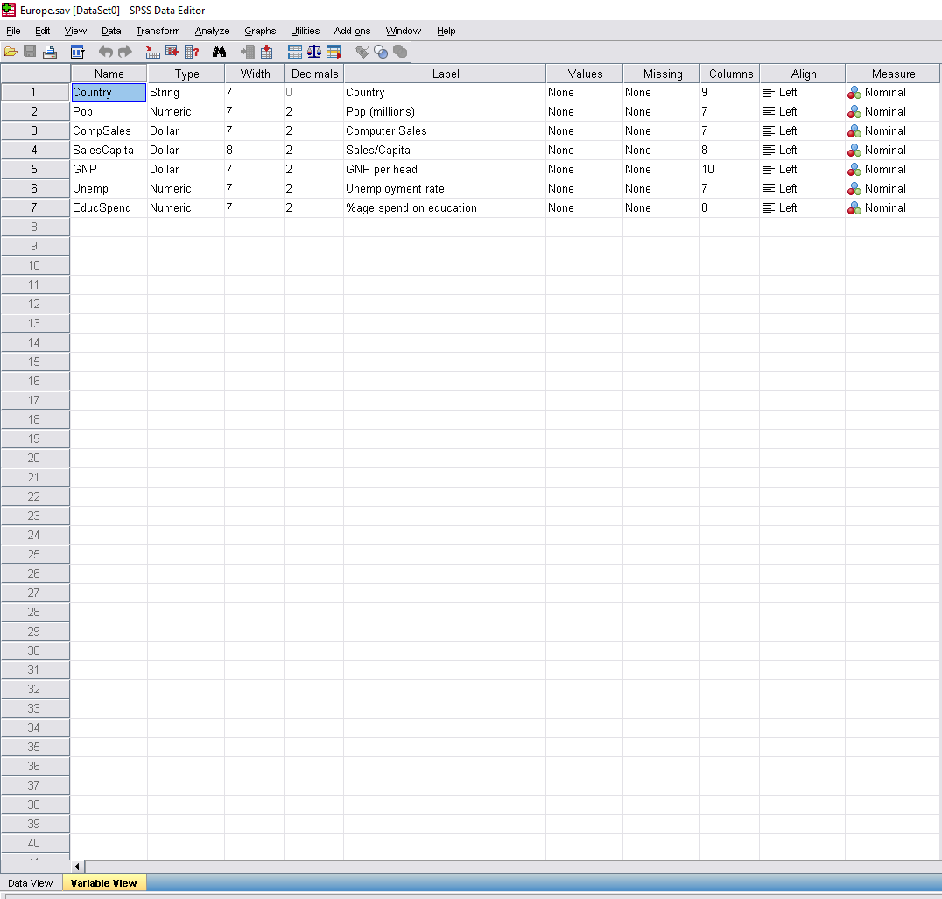
Standardized Coefficients (cont’d)
When you open the file, it should give you the “Data View” by default. This looks very much like an Excel spreadsheet, except that the header row is not just another row of data, but rather is external to the data itself
If you click on the tab at the bottom of the screen, you can switch to the “Variable View” which gives you information about the data in the Data View

Slide 12
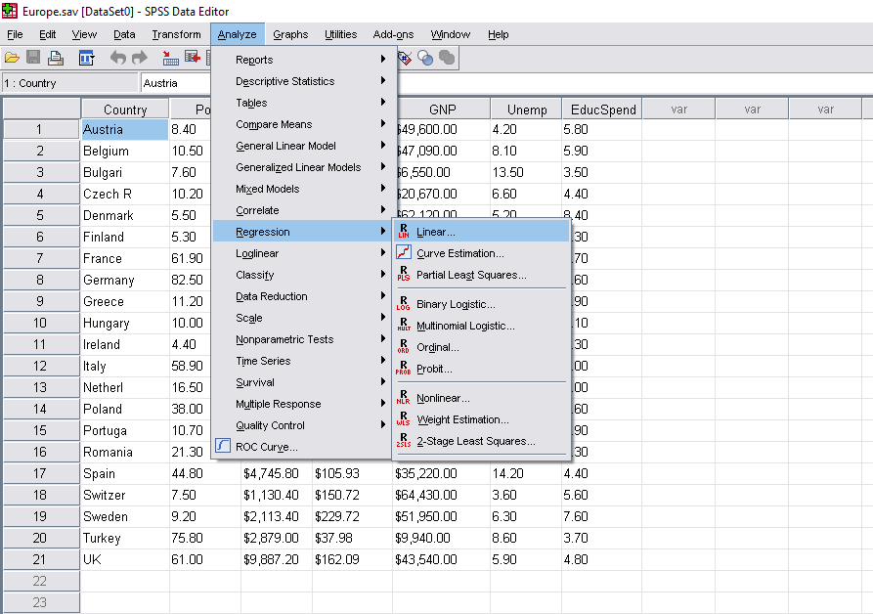
Standardized Coefficients (cont’d)
From either view (I’m going back to the Data View for this demonstration), you can select Analyze → Regression → Linear from the menu above

Slide 13
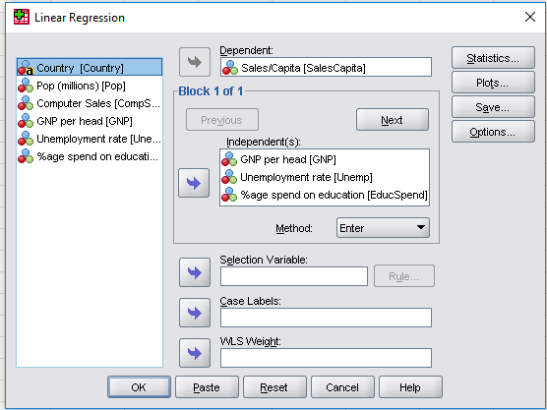
Standardized Coefficients (cont’d)
In the dialogue box that appears, select SalesCapita as the Dependent and GNP, Unemp and EducSpend as the Independent(s)
Leave everything else at its default setting for now. Click OK…

Slide 14
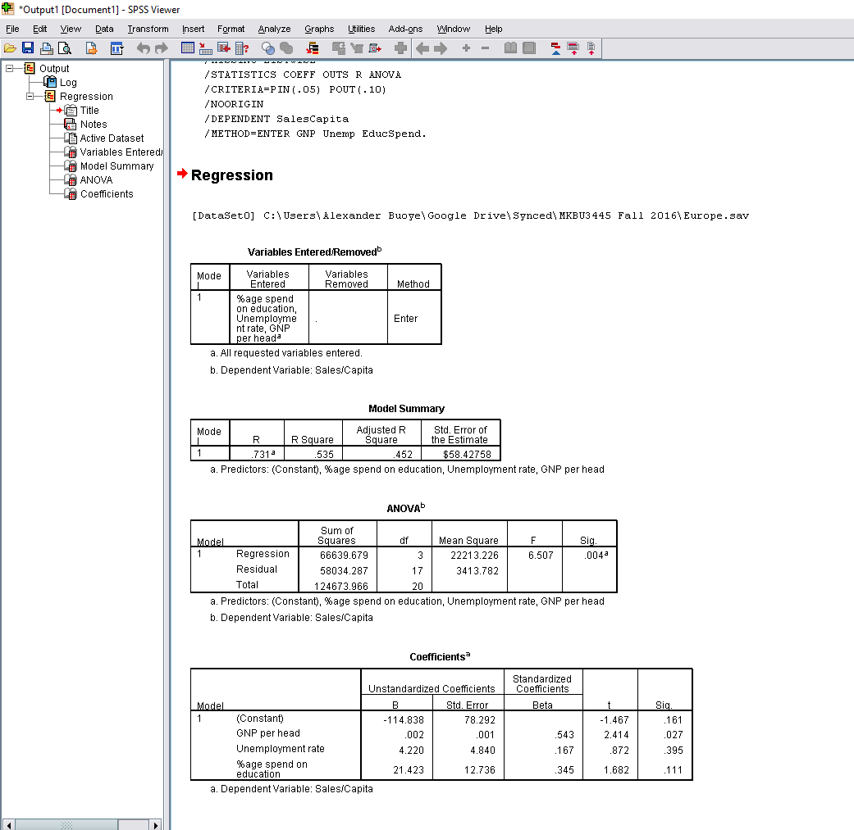
Standardized Coefficients (cont’d)
SPSS Produces the following output in a separate window (the “Output” or “SPSS Viewer”)
The results are the same as when we ran the regression in Excel using the Data Analysis Tookpak
Notice, however, that SPSS produces both “Unstandardized Coefficients” (B, which is equal to the results from Excel) as well as Standardized Coefficients (Beta), which were not included in the Excel output

Slide 15
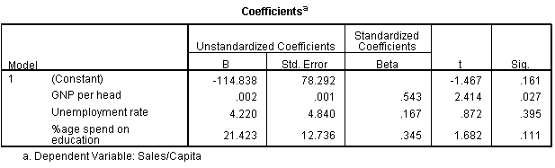
Standardized Coefficients (cont’d)
We can interpret these standardized coefficients such that GNP per head has the greatest “impact” because its beta (.543) is the largest. Unemployment rate has the smallest “impact” (.167).
This is the opposite of what one might conclude based on the metric coefficients, where B for GNP per head appears very small (.002) and B for Unemployment rate appears very large (4.22), but this is due only to the way the variables are measured and not a reflection of the relative strength of the relationship between each independent variable and the dependent variable

Slide 16
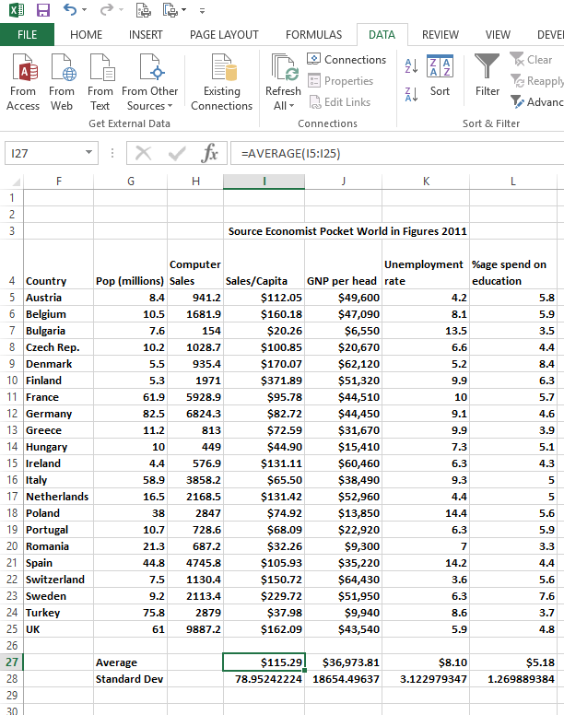
Standardized Coefficients (cont’d)
In order to get those numbers in Excel, we need to convert the original variables into their Z-score transformations (i.e., “standardize” the variables)
This is actually quite easy to do…
Open up the Europe.xlsx workbook again and go the “data” worksheet.
For each of the 4 columns of interest, calculate the Average (e.g., =AVERAGE(I5:I25)) and Standard Deviation (=STDEV(I5:I25))for the column below the table…

Slide 17
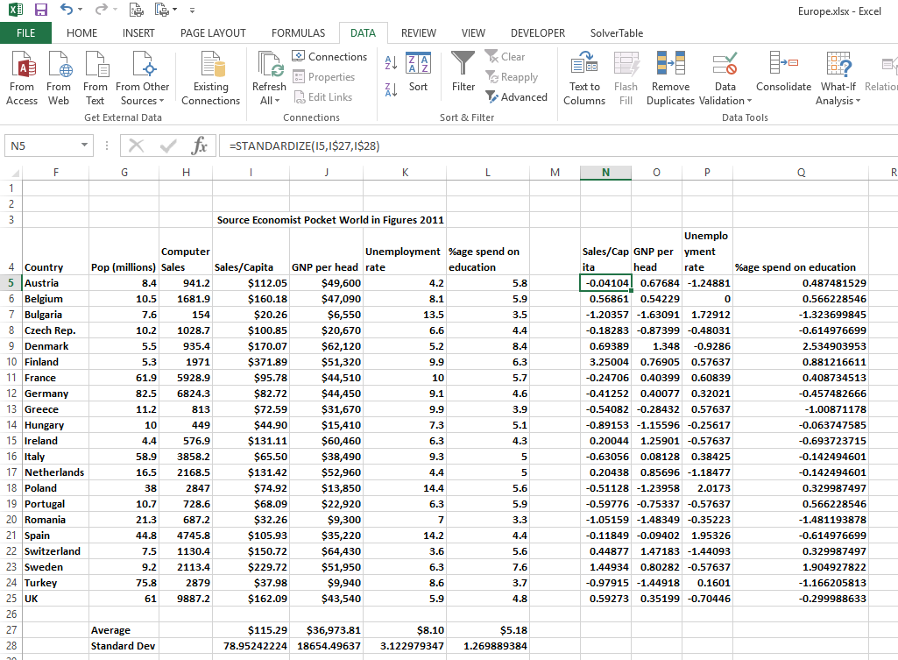
Standardized Coefficients (cont’d)
Next we will calculate four new columns of data using the =STANDARDIZE function. The STANDARDIZE function has the following format: =STANDARDIZE(x,mean,std dev) where x is the value of interest, mean is the mean for that column/variable and std dev is the standard deviation for that variable
For example:

Slide 18
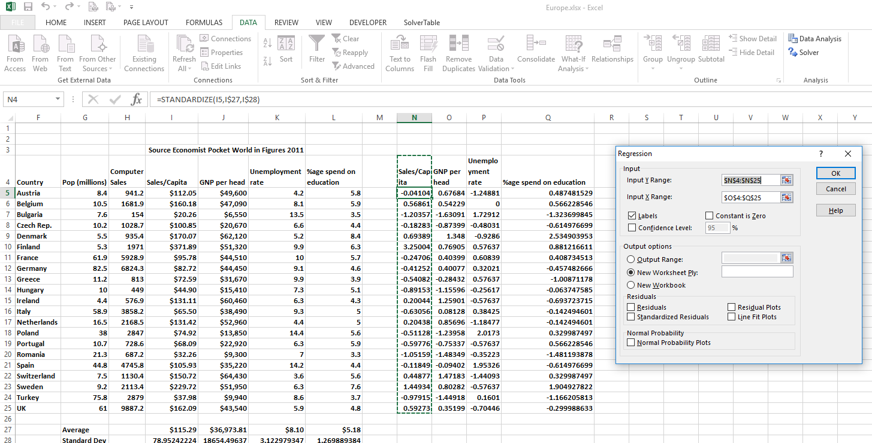
Standardized Coefficients (cont’d)
Last, re-run your regression on these standardized columns of data, using the Data Analysis Toolpak

Slide 19
Standardized Coefficients (cont’d)

Slide 20
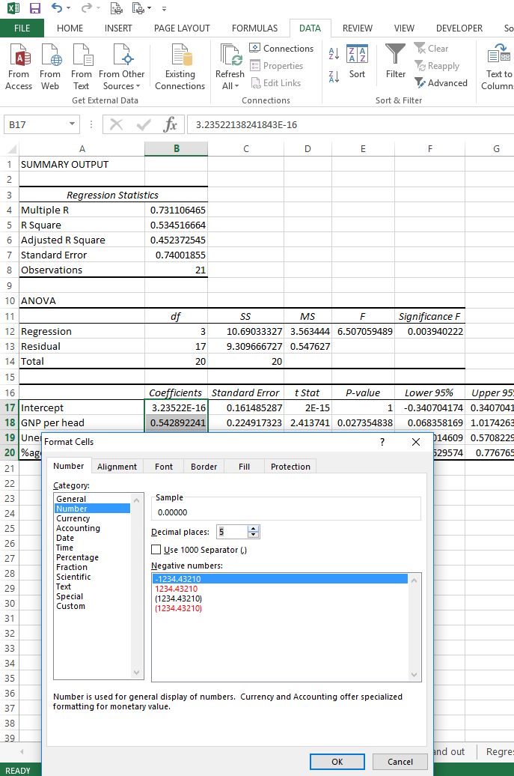
Standardized Coefficients (cont’d)
The coefficients come out in that annoying scientific notation, but you can change the cell format to be regular numeric…
All the fit statistics (e.g., R-square, etc) should be the same as before
The final coefficients should match what you had for the betas in SPSS:

Slide 21
Standardized Coefficients (cont’d)
In terms of predictive value (i.e, for forecasting purposes), standardized coefficients don’t really offer you any particular benefit
Professor Mohammad Nejad covers forecasting in his Data Driven Marketing Decisions class, and of which I have taken the reference of.
But regression is used for applications beyond forecasting and prediction…
It’s really only for applications where you are primarily interested in interpreting the relative impact of the independent variables rather than predicting the dependent variable that betas become preferable
Using regression for key drivers analysis (which we previously did with correlations) would be one application, although standardizing variables does not make issues like common method bias go away
For example, if you measure overall satisfaction on a 10-point scale, some drivers on a 10-point scale and others on a 5-point scale, the drivers measured on the same scale as the dependent variable will tend to have a stronger relationship just because they were measured the same way
Standardizing the data does not change that

Slide 22
Dummy Variable Coding
Sometimes you want to include categorical (i.e., nominal, string, non-numeric) information ion your regression equation
Unfortunately, you can’t just stick nominal data directly into a regression (well, you can, in SAS, using a class statement, in some procedures, but I digress…)
The good news is that you can actually do it, but like with estimating standardized coefficients in Excel, you have to do some upfront data work first
Dummy variables take on only two values: 0 and 1
Typically a value of 0 indicates the absence of a characteristic or property, while a 1 indicates the presence of that characteristic or property

Slide 23
Dummy Variable Coding (cont’d)
For example, let’s say you had a sample of college students and you wanted to include their class (freshman, sophomore, junior, senior) as a variable in a regression
Instead you could create four dummy variables
Note: the number of dummy variables included in the regression is always one less than the number of categories
One of the categories becomes the “reference” category
The coefficients of the dummy variables indicate how much those categories differ from the reference category on the dependent variable (controlling for whatever other variables are in the regression model)
The data would look something like this:

Slide 24
Dummy Variable Coding (Cont’d)
There are several techniques for analyzing categorical data, which don’t necessarily involve dummy coding
But dummy coding is a very common method for including categorical data in a regression
There are other methods for coding categorical data for inclusion in a regression (e.g., effect coding), but we will not discuss those now

Slide 25
Using Dummy Variables in a Regression
Look at the Europe.xlsx file again.
We can create a dummy variable as an indicator of “Balkan” countries based on the “Country” variable
Five of the countries are located at least partly in the Balkan region: Bulgaria, Greece, Italy, Romania, and Turkey
Create a new dummy variable called “Balkan”, where the row is coded 1 for the 5 countries listed above and 0 otherwise

Slide 26
Using Dummy Variables in a Regression (cont’d)
Re-run the regression including this new variable
The p-value of .686 indicates that there is not a significant difference in the average sales of computers per capita between Balkan and non-Balkan countries

Slide 27
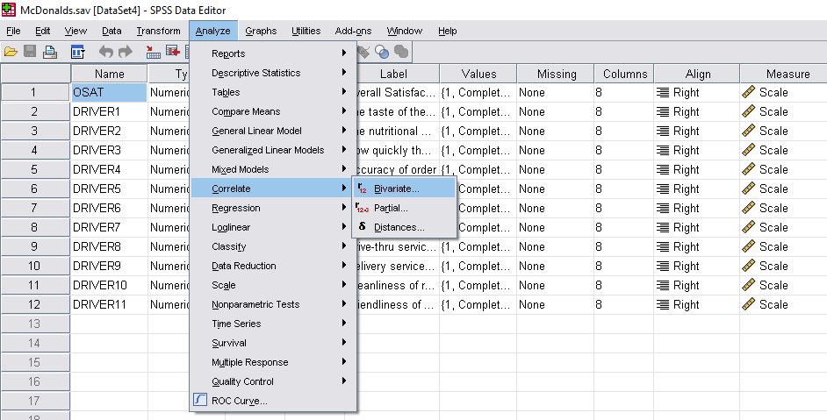
Multicollinearity
Excel doesn’t really provide a lot of tools for diagnosing multicollinearity
SPSS is much better
Open the file McDonalds.sav
This is the same data file we used in Excel to calculate correlations
Select Analyze → Correlate → Bivariate from the menu and you should get the same correlations that you previously got using Excel.
Note: All the bivariate correlations are positive, as you would expect.

Slide 28
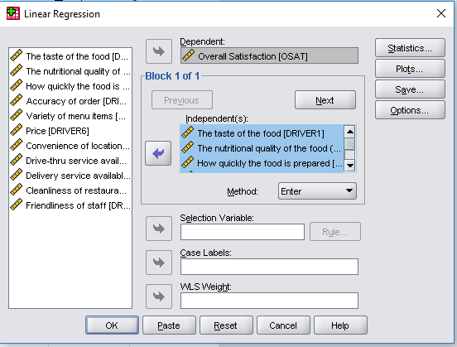
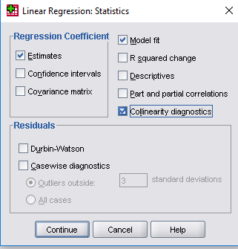
Multicollinearity (cont’d)
Next, select Analyze→ Regression → Linear from the menu again, and select OSAT as the dependent variable and DRIVER1-DRIVER11 as the independent(s)
Before clicking “OK”, click in “Statistics”
In the box that pops up, check off “Collinearity diagnostics” then click “Continue” and “OK”

Slide 29
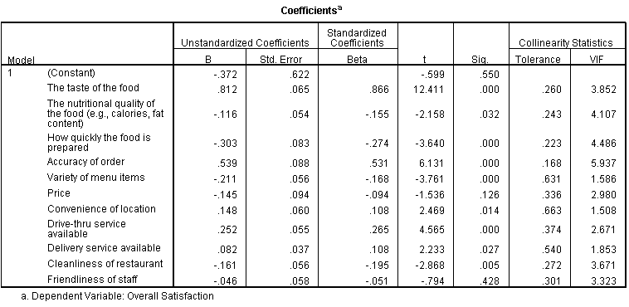
Multicollinearity (cont’d)
Without going too deep into it at this point, I want you to notice what happens to your model – in short, a lot of negative coefficients, which suggest that higher satisfaction with some aspects of the customer experience leads to lower satisfaction overall
This is nonsensical
It is the result of inflated standard errors of the estimates due to multicollinearity

Slide 30
Multicollinearity (cont’d)
The easiest way to diagnose multicollineraity problems (aside from all the negative coefficients!) is to look at the VIF values.
Rule of thumb: if any of these are over 4, you have a problem
I will present in my thesis defense presentation, how you can use factor analysis to deal with this problem

Slide 31
DESCLAIMER
This File is only for the internal teaching & research assistant purposes. It is personal work of Priyanka Brahmbhatt with an intention to use this material for application of Phd.
This shall not be used in the class teaching without presence of Priyanka Brahmbhatt unless the there is an agreement and the department of data sciences & Priyanka Brahmbhatt chooses to make this material available for all the faculties.

